Slide 1


Sentimental Analysis Microservice
Sensitivity: General
1 Copyright © 2022 Virtusa Corporation. All Rights Reserved.
JAI DEEPAK S H
HARRISHWAR M
KEERTHIVASAN R
JAGADEESH A
JEEVA SAKTHI S
Rajalakshmi Institute of Technology

Slide 2
Business Need/ Opportunity
Sensitivity: General
Identification of Business Problem
Need Assessment Value Proposition
2
Copyright © 2022 Virtusa Corporation. Alll Riights Reserved..

Slide 3
Business Problem/Need/Opportunity
Sensitivity: General
Explain the business problem or a need with details
problem - prevent customer loss from cross selling and also improve market growth
unmet needs- recommend the product based on financial(able to buy). most of customer need best product with low price and it may be affordable
people mostly not like unwanted product (It is important to address)
customer buy more product and also they recommend our product to neighbour .It help to gain new customer .customer is satisfied through our service they will
not go to other companies
3
Copyright © 2022 Virtusa Corporation. All Rights Reserved.

Slide 4
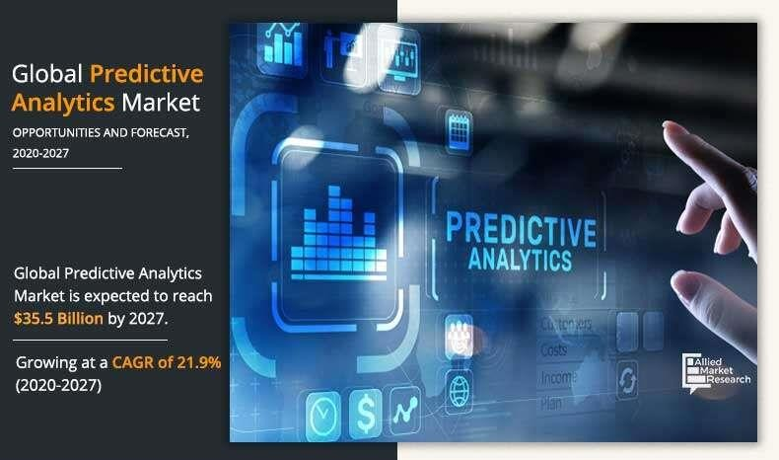
Market Potential
Sensitivity: General
Target Segment / Market Sizing
Brands can use sentiment analysis to track their own online mentions and the feelings attached to them, and they can also track competitor mentions for comparison purposes.
4
Copyright © 2022 Virtusa Corporation. Alll Riights Reserved..

Slide 5
Target Segment/Market Size
Sensitivity: General
Identify and describe about the target segment? Estimate the market size and potential growth
customer/ target segment - common people(Those who looking for product with best and lower cost .Also it satisfy their needs )
market size - $16 billion
market growth - $3.6 billion
5
Copyright © 2022 Virtusa Corporation. All Rights Reserved.

Slide 6
Solution Details
Sensitivity: General
Explanation/Articulation of Solution Idea
Differentiation/ Unique Selling Proposition Solution Demo
6
Copyright © 2022 Virtusa Corporation. Alll Riights Reserved..

Slide 7
Solution Details
Sensitivity: General
First gather the user past activities data
Important note that what price they expect to buy the most of the product.And also note that they like to buy related product
Make analysis to find out the financial status of consumer and also their product interest they only looking brand product or buy a product based on cost).based on their interest we should recommend the product
Lastly find out response of the product they buy (its satisfy them or not )-using sentimental analysis
Copyright © 2022 Virtusa Corporation. All Rights Reserved.

Slide 8
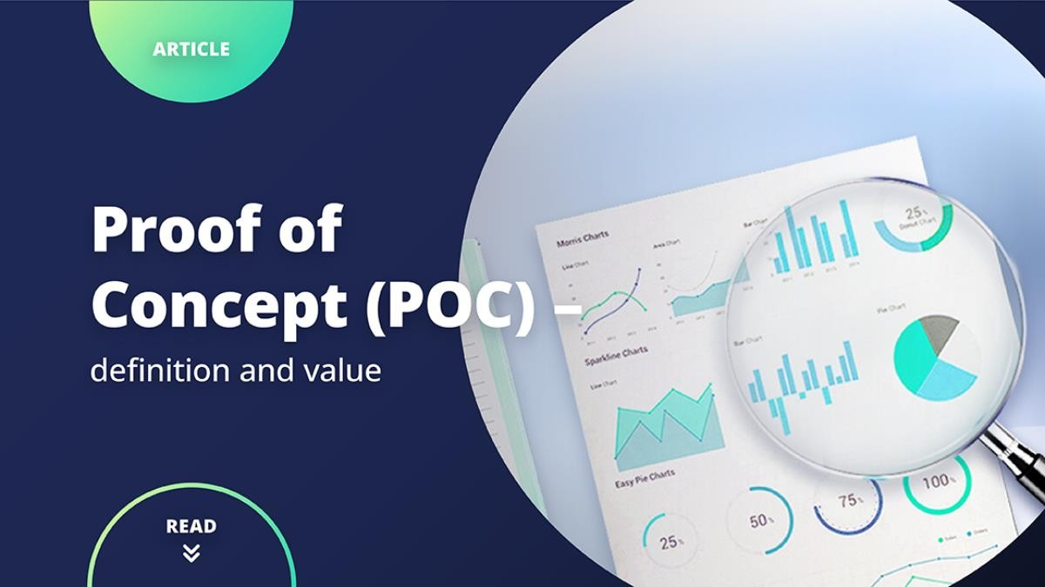
Sensitivity: General
Copyright © 2022 Virtusa Corporation. All Rights Reserved.

Slide 9
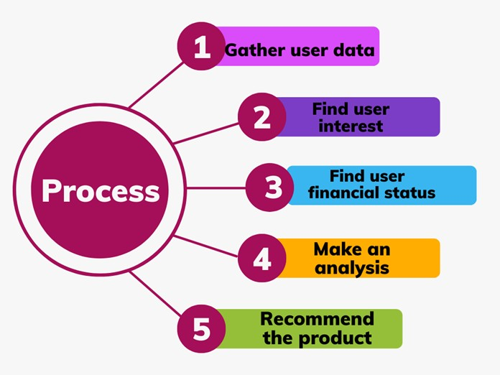
Proof of concept
Sensitivity: General
Copyright © 2022 Virtusa Corporation. All Rights Reserved.

Slide 10
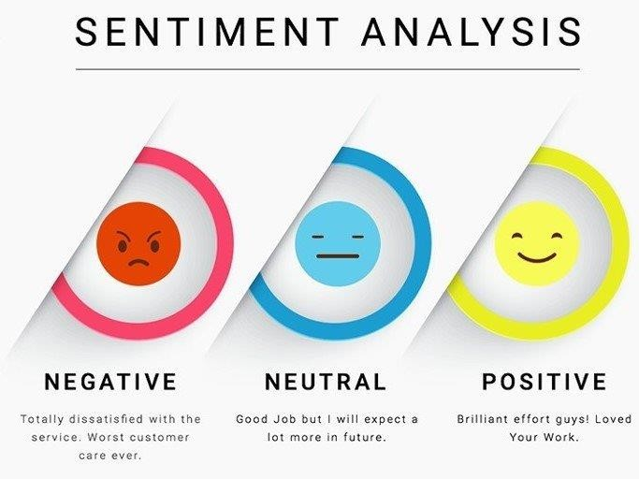
Feedback Analysis
Sensitivity: General
Copyright © 2022 Virtusa Corporation. All Rights Reserved.

Slide 11
Future Readiness
Sensitivity: General
Solution Roadmap
Cross-Industry application
Copyright © 2022 Virtusa Corporation. Alll Riights Reserved..

Slide 12
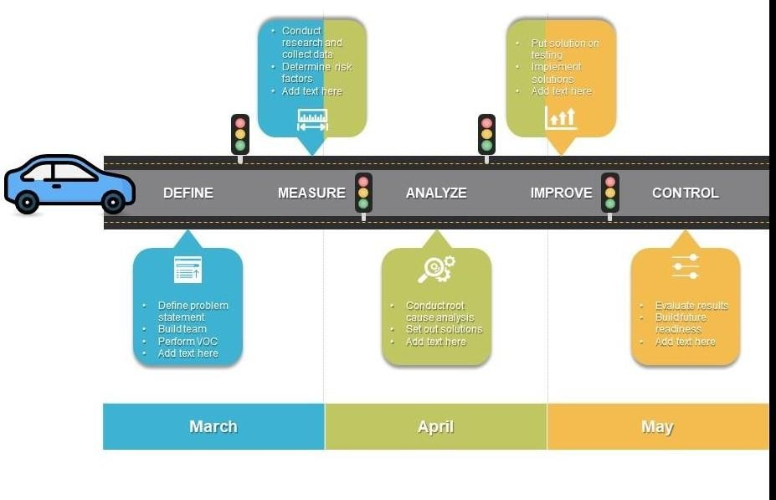
Future Readiness
Sensitivity: General
we can also apply this method for identify the user satisfaction about various mobile application
Copyright © 2022 Virtusa Corporation. All Rights Reserved.

Slide 13
About the Team
Sensitivity: General
We are currently pursing Computer Science Engineering at Rajalakshmi institute Of technology . Our team has previously done some of the projects on App development . This is the first time in this field , we have put our effort in this project . Thanks for giving the opportunity.
Copyright © 2022 Virtusa Corporation. Alll Riights Reserved..

Slide 14
Thank You
Sensitivity: General
Copyright © 2022 Virtusa Corporation. Alll Riights Reserved..

